Slide 1
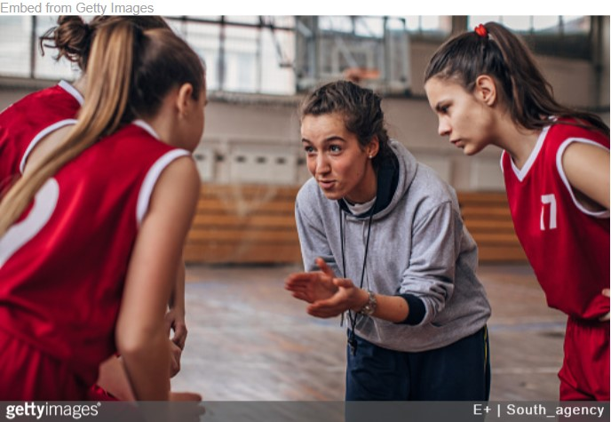



Slide 2

The number one way to excel as a coach or leader?

Slide 3
The number one way to excel as a coach or leader?
It’s not…
- To win.
- To create successful teams.
- To help athletes reach their highest sporting potential.

Slide 4
The number one way to excel as a coach or leader?
To inspire athletes on an individual level.
- Emphasizing fun.
- Creating a culture around positivity, mastery, and long-term growth, over performance, wins/losses and short-term gains.
- Building a connection with each athlete and recognizing that each athlete is unique.

Slide 5
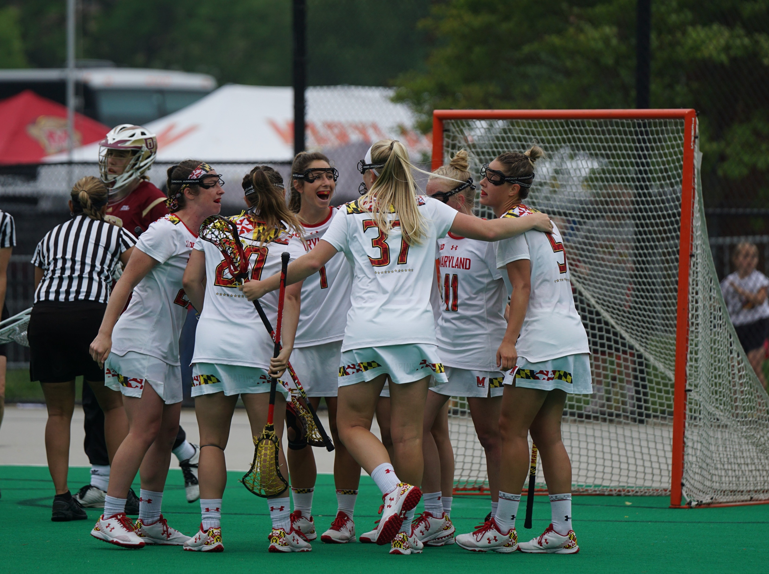
In doing so, you will…
Inspire athletes to return to sport year after year.

Slide 6
This will be at the forefront of this course…
We are working to…
- Maximize fun
- Maximize participation
- Build individual connections that recognize the differences of each athlete inside and outside of sport.
- Inspire athletes to return to sport year after year.

Slide 7
Unfortunately, traditional coaching methods have a problem…
Many coaches focus on…
- Wins/losses
- The performance of players
- Technical skill development, with no correlation to the game
- Pushing athletes beyond their physical limits

Slide 8
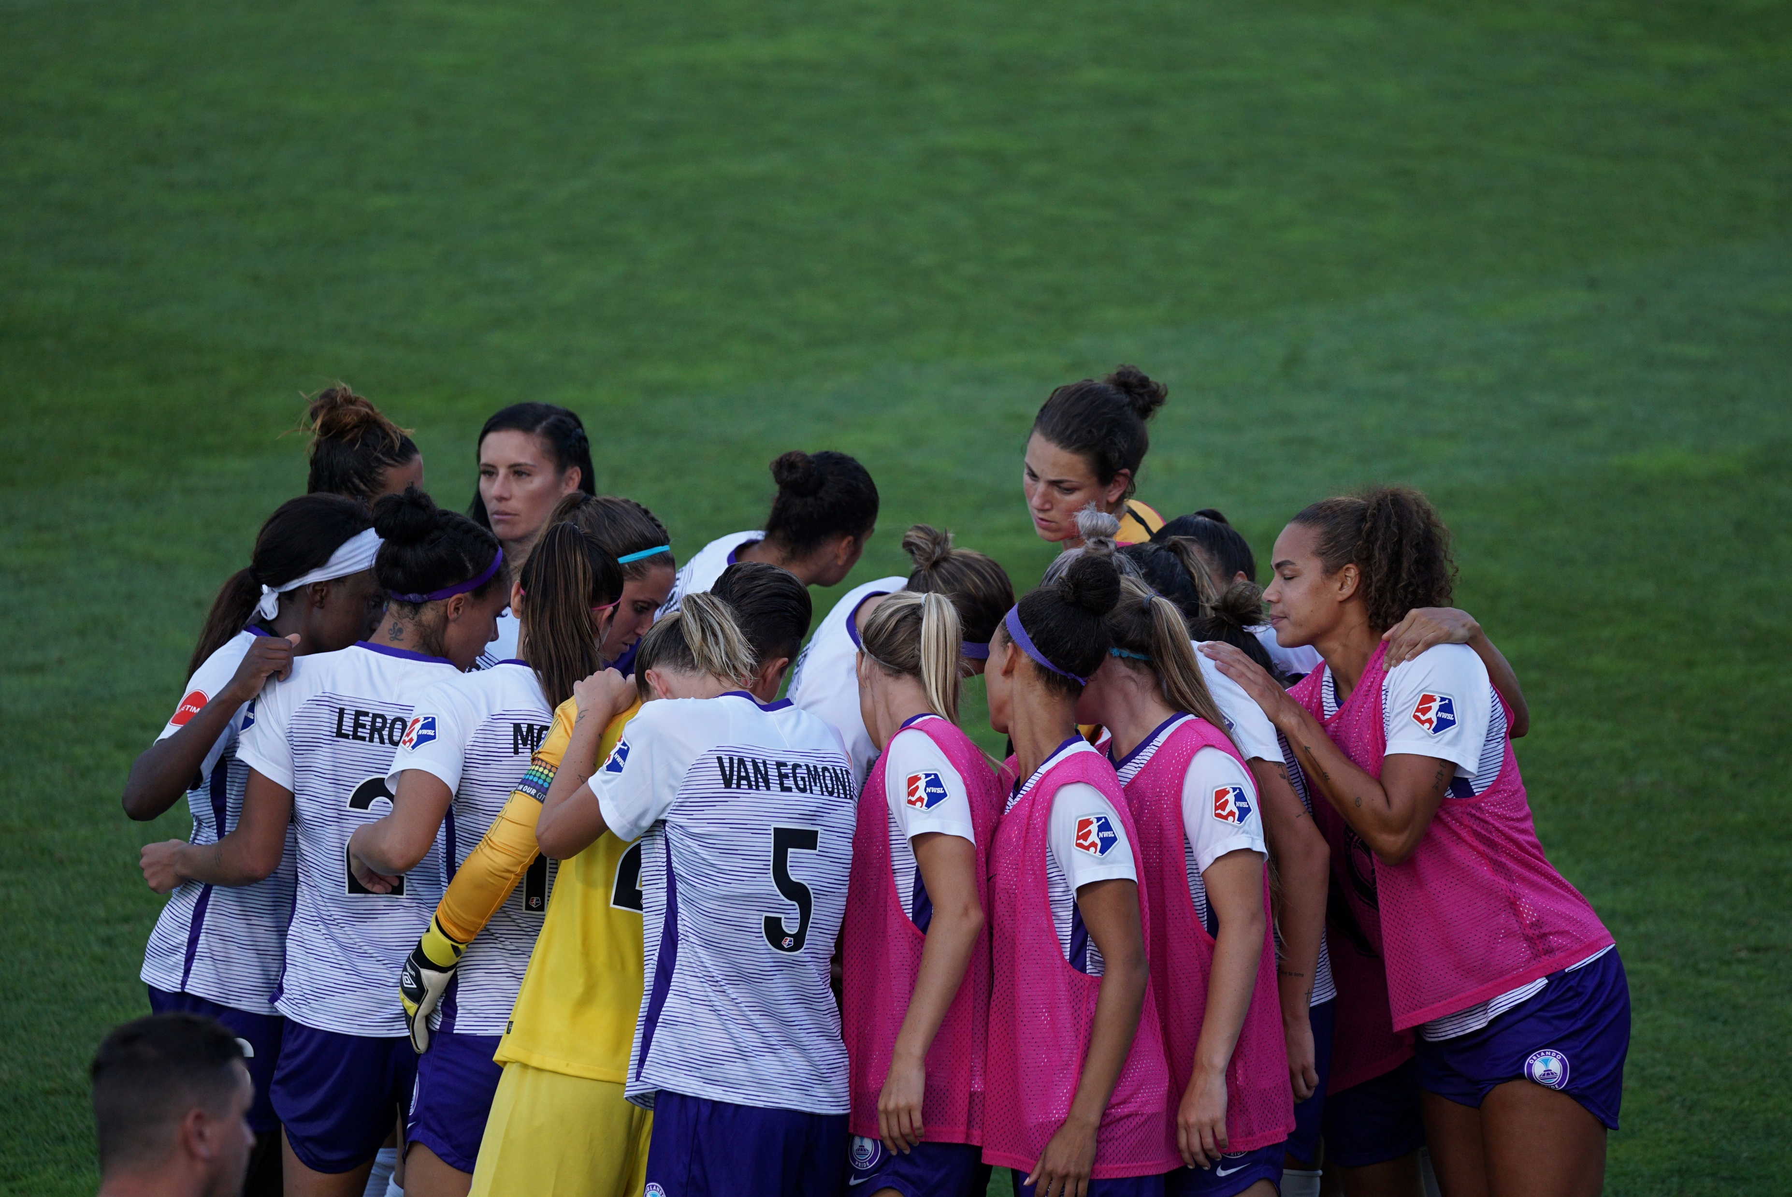
Modern day coaches recognize that…
There is no ‘one size fits all’ to coaching.
Athletes have a range of factors that impact performance, learning, growth
and FUN! (‘5 CORNERS’).
Achieving success is not measured by wins/losses, but by the way you inspire athletes to have fun and be their best selves, to the extent where they return next year.

Slide 9
LET’S TALK!
Tell me about your favourite trait of a coach or leader you had growing up?

Slide 10


Chances are…
What you just wrote spoke more to how the coach made you feel, than their knowledge of the sport.

Slide 11
Looking back on their experiences, athletes don’t remember…
- Wins/losses.
- The ins and outs of competition.
- The specific advice you gave them when developing a skill.

Slide 12
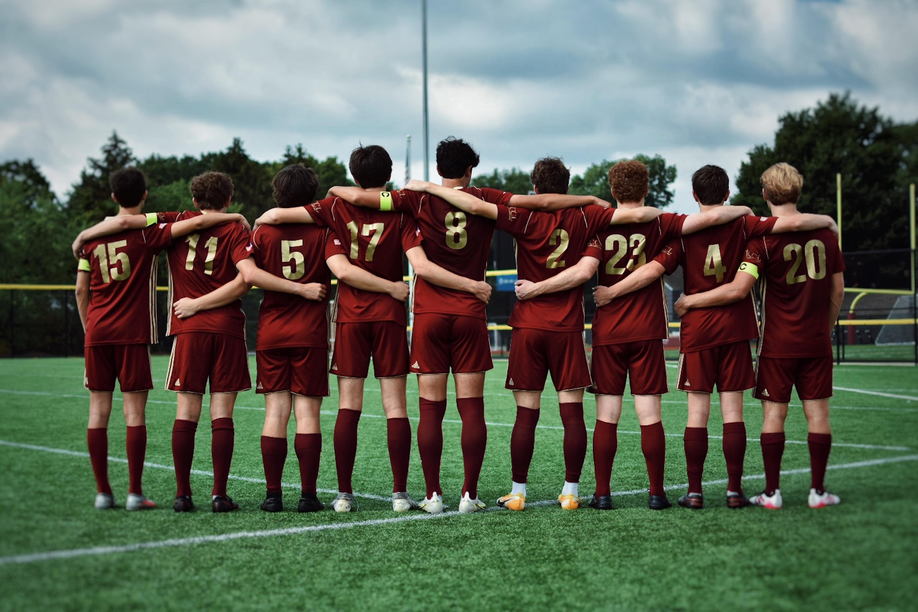
Instead athletes remember…
- The experience they had playing the sport. Was it good, bad, fun?
- The people that made the experience what it was, for better or for worse.
- How you made them feel.

Slide 13
So how do you accomplish that?

Slide 14
- Pledge your allegiance to this course. Go “all in” on your learning and take a deep dive with me on how to create optimal learning environments for your athletes.
- Supplement your learning in this course with further research and readings on TMS.
- Conduct your own research by putting your learnings into practice, and thinking about how these learnings can intertwine with your life.
-> Join our Patreon for exclusive resources to take your game to the next level.

